Slide 1
Bagging and Random Forest
UIUC ECON 490: Applied Machine Learning in Economics

Slide 2

How Many Chocolate Chips?
https://docs.google.com/spreadsheets/d/1BySA4qb7mCWwe34U9IP49tag-IofpJAqHSVUcMOSIAM/edit?usp=sharing

Slide 3
Wisdom of the Crowds
Suppose asking the question:
When will life return to normal after COVID?
Two options for best prediction:
A random epidemiologist
Average several experts: epidemiologists, MDs, historians, economists, supply chain analysts
Who wins?

Slide 4
Thinking of experts as models…
Expert type is to model class
Economist – OLS
Epidemiologist – decision tree
Historian – SVM
Each expert has different and similar experiences
Trained on overlapping samples of data
Ensemble learning
Bagging
Boosting
Stacking
Today
Bagging with decision trees

Slide 5
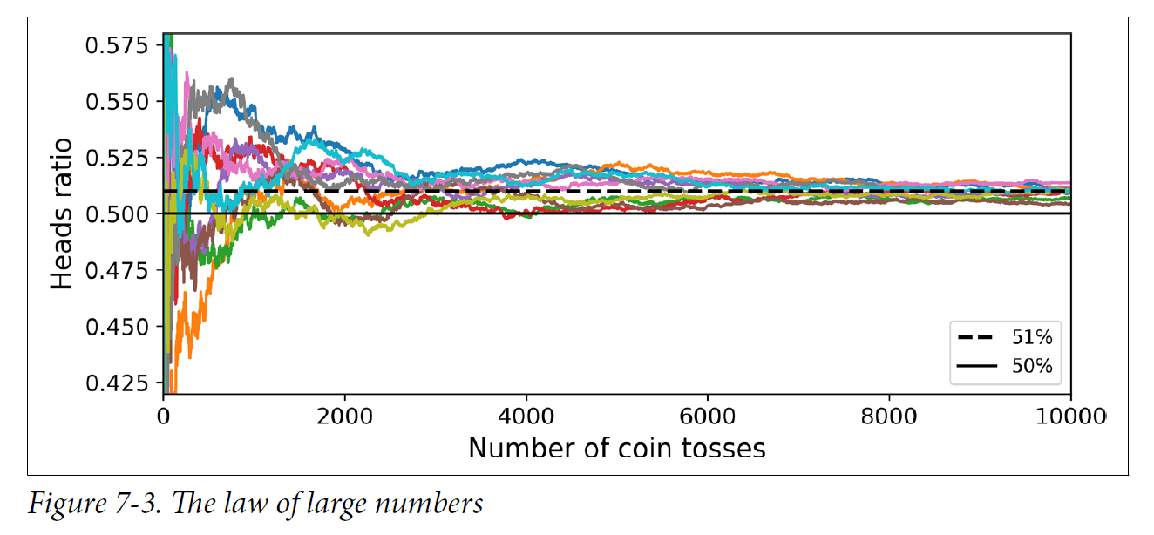
Visual Law of Large Numbers with Biased Coin

Slide 6
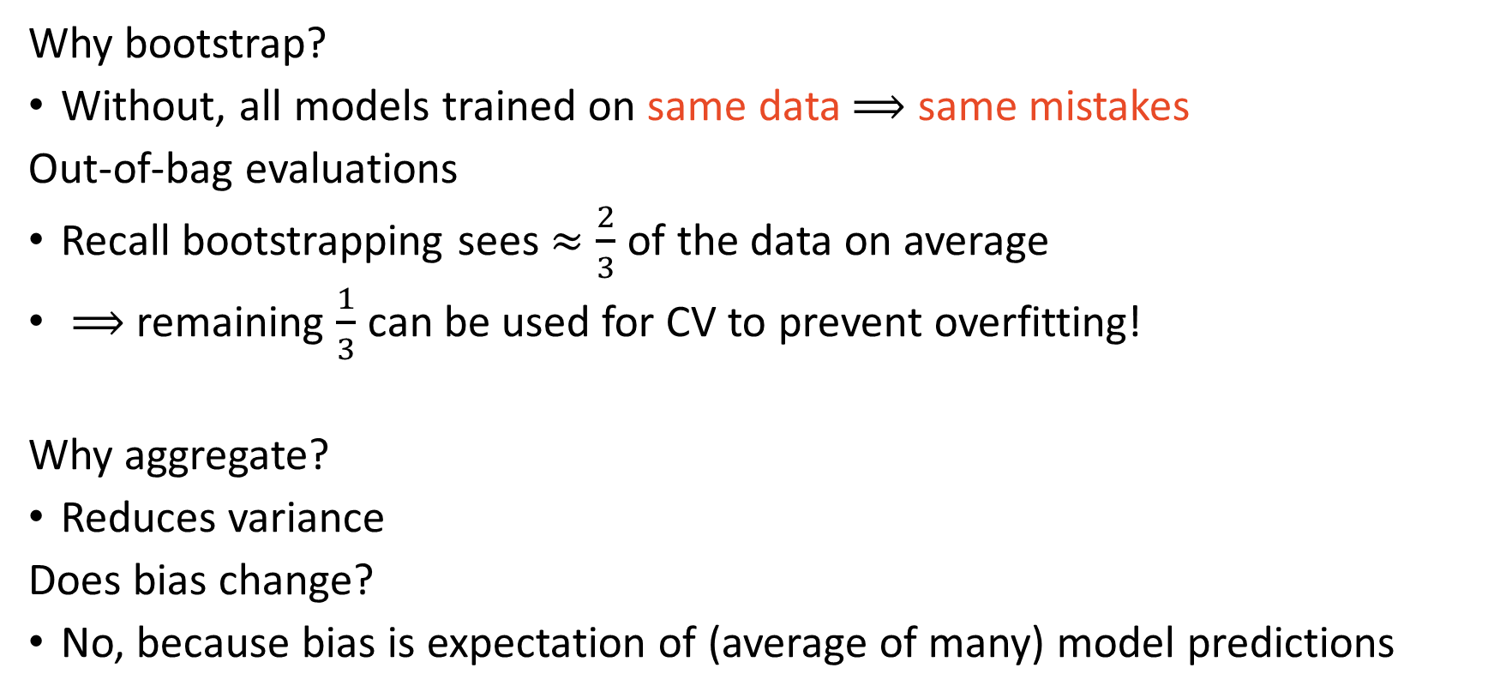
Bootstrap Aggregating
Why bootstrap?
Without, all models trained on same data $⟹$ same mistakes
Out-of-bag evaluations
Recall bootstrapping sees $≈\frac{2}{3}$ of the data on average
$⟹$ remaining $\frac{1}{3}$ can be used for CV to prevent overfitting!
Why aggregate?
Reduces variance
Does bias change?
No, because bias is expectation of (average of many) model predictions

Slide 7
Decision trees are well suited for ensemble learning
Decision trees have low bias but high variance
Bias – level of correctness on average (detecting biased coin)
Variance – sensitivity to training data
Bagged trees
Fit many trees
Significantly more accurate
Loses interpretation (what we originally liked about trees)

Slide 8
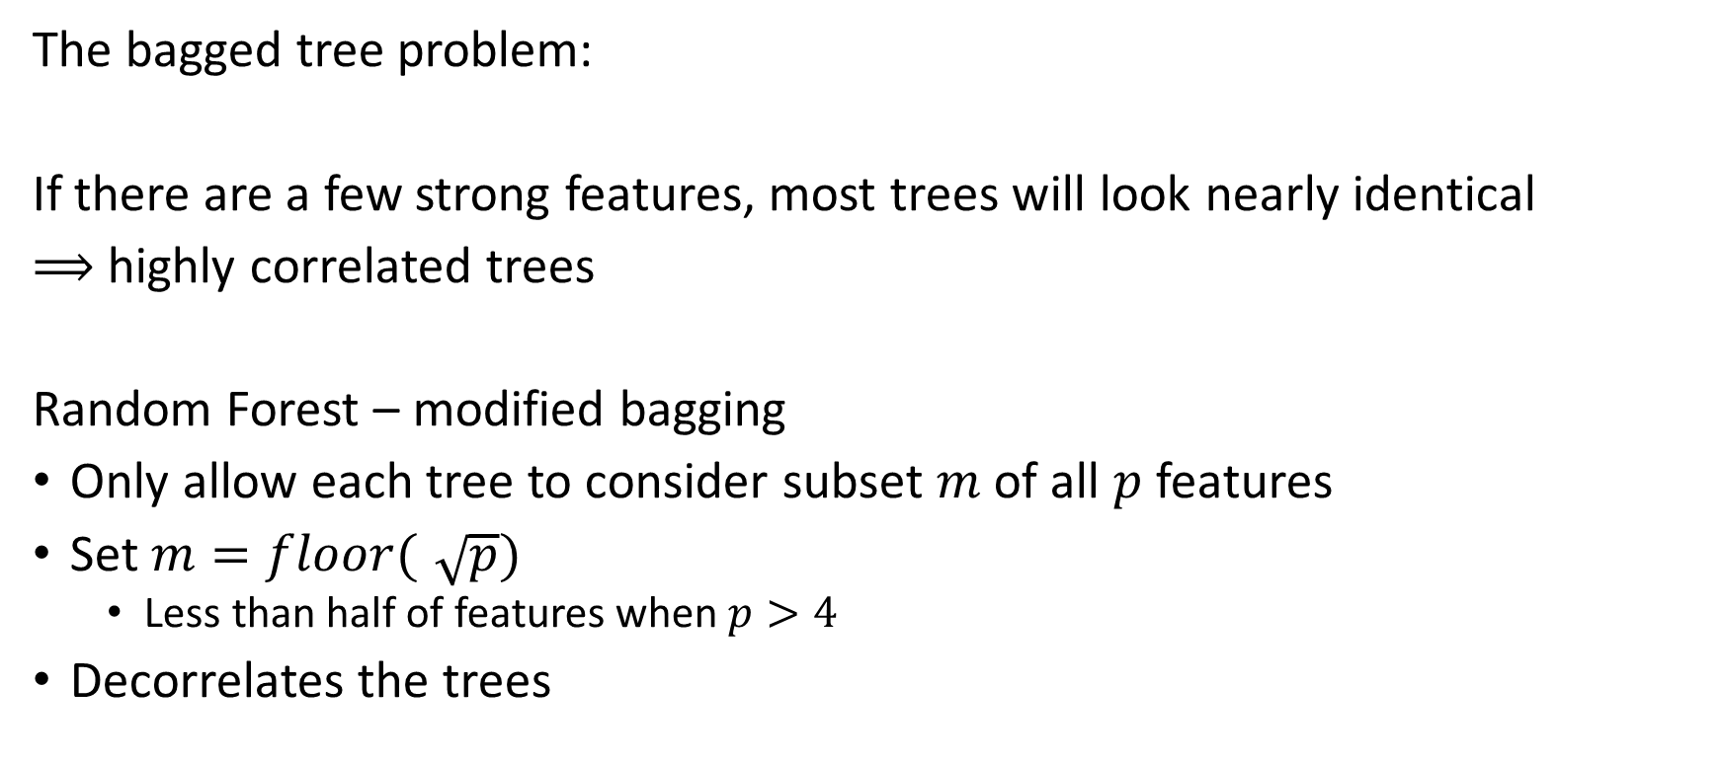
Random Forest solves issues of Bagged Trees
The bagged tree problem:
If there are a few strong features, most trees will look nearly identical
$⟹$ highly correlated trees
Random Forest – modified bagging
Only allow each tree to consider subset $m$ of all $p$ features
Set $m=floor(\sqrt{p})$
Less than half of features when $p>4$
Decorrelates the trees

Slide 9
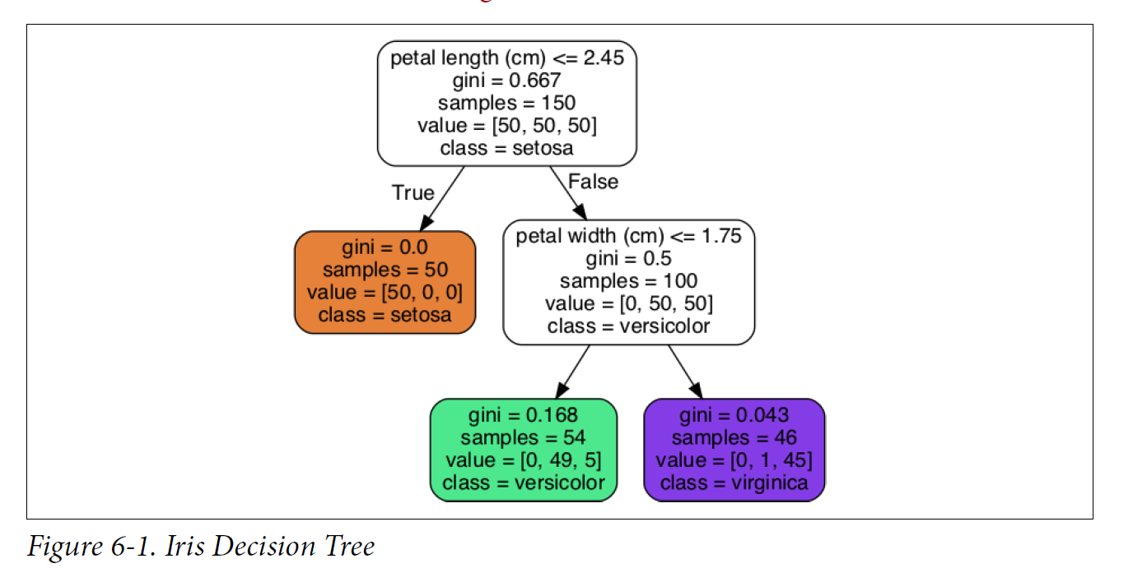

Feature Importance
How important is each feature ($x$)?
Weighted average
of the feature’s…
Reduction of
impurity across all
trees that use it
Weighted by
number of training
samples using it

Slide 10
Implementation Scikit-Learn
sklearn.ensemble.RandomForestClassifier()
sklearn.ensemble.RandomForestRegressor()
Important parameters:
All decision tree parameters
n_estimators: number of trees
max_leaf_nodes: ~4 number of terminal nodes OR
max_depth: ~2 (four terminal nodes)
random_state: 490
oob_score: “False” whether or net to estimate out-of-bag score
n_jobs: -1 is all CPU cores
I like to leave a few available

Slide 11
Main Takeaways
Ensemble learning uses many models reduces variance and improves accuracy*
* In general
Random forest solves the bagged tree problem
Feature importance is the predictive strength of the feature

